Slide 1
BDD Lunch & Learn
March 2, 2011

Slide 2
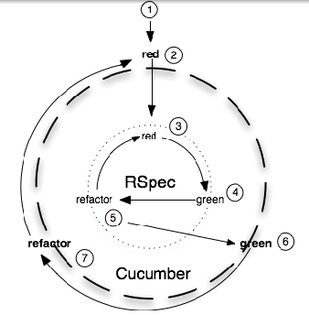
Why BDD
Automated evaluation from the perspective of the user
Tests behavior of the system
Executable requirements
But, it is not enough
Notes:
Tests from the perspective of the user
Tests behavior of the system
Executable requirements, codefied
not disposable artifacts

Slide 3
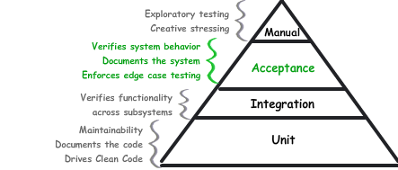
Acceptance Tests vs. Unit and Integration Tests
Notes:
TDD is a development practice

Slide 4
Cucumber
Describes how software should behave in plain text
Gherkin
Usable in many different human languages (even LOLZ!)
Features can be written and understood by both non/technical project members
Not a replacement for unit testing; it’s not a low level testing/spec framework

Slide 5
Features
Something that your software does (or should do)
Corresponds to a user story
Executable Requirements
Documentation of the system
Automated tests
General Format:
Feature: <short description>
<story>
<scenario 1>
...
<scenario n>

Slide 6
Features
Who’s using the system?
What are they doing?
Why do they care?
As a <role>
I want <feature>
So that <business value>
Notes:
Within the definition of a feature you can provide a plain text description of the story, focusing on three important questions:

Slide 7
Scenarios
Features are defined by one or more scenarios
Sequence of steps thru the feature that exercises on path
Use BDD style – given-when-then
Scenario: <description>
<step 1>
…
<step 2>

Slide 8
Scenarios
Given
Sets up preconditions, or context, for the scenario
When
The action, or behavior, that we’re focused on
Then
Checks post-conditions
Verifies that the right thing happened in the When stage
And
Notes:
And can be used in any of the three sections
It serves as nice shorthand for repeating the Given, When, or Then
And stands in for whatever the most recent explicitly named step was

Slide 9
Feature: Adding CA vehicles
As a GAINWeb user
I want to cancel out of adding a vehicle
So that only the number of vehicles I want get added
Background:
Given that I am adding a "CA" quote for "IA"
And I enter all the data up to Adding A Vehicle
Scenario: Cancelling out of Adding a Vehicle
When I enter "WMWMF33539TU74123" as the VIN
And I select "MINI COOPERS" as the Make
And I select "Private Passenger" as the vehicle type
And I select "Business Purposes" as the vehicle use
And I select "No" for the Additional Insured
And I press "Add Vehicle"
And I press "Return to Main Menu"
And I re-open the policy
And I navigate to the "Vehicles" page
Then I should not get the error "Vehicle Garaging Location not specified"

Slide 10
Scoring Bowling.
The game consists of 10 frames as shown above. In each frame the player has
two opportunities to knock down 10 pins. The score for the frame is the total
number of pins knocked down, plus bonuses for strikes and spares.
A spare is when the player knocks down all 10 pins in two tries. The bonus for
that frame is the number of pins knocked down by the next roll. So in frame 3
above, the score is 10 (the total number knocked down) plus a bonus of 5 (the
number of pins knocked down on the next roll.)
A strike is when the player knocks down all 10 pins on his first try. The bonus
for that frame is the value of the next two balls rolled.
In the tenth frame a player who rolls a spare or strike is allowed to roll the extra
balls to complete the frame. However no more than three balls can be rolled in
tenth frame.

Slide 11
Shawn Wallace
c-wallas@grangeinsurance.com
614.270-1600
Andy Vida
vidaa@grangeinsurance.com
614-445-2784

Slide 12
For more info…
cukes.info
https://github.com/aslakhellesoy/cucumber/wiki
http://groups.google.com/group/cukes
http://www.cheezyworld.com
Samples and Presentation: git@github.com:shawnewallace/Katas.git
The Rspec Book, David Chelimsky: http://www.pragprog.com/titles/achbd/the-rspec-book

